Slide 1
Akrasel Kindergarden
Unesco- and Eco school in Iceland

Slide 2
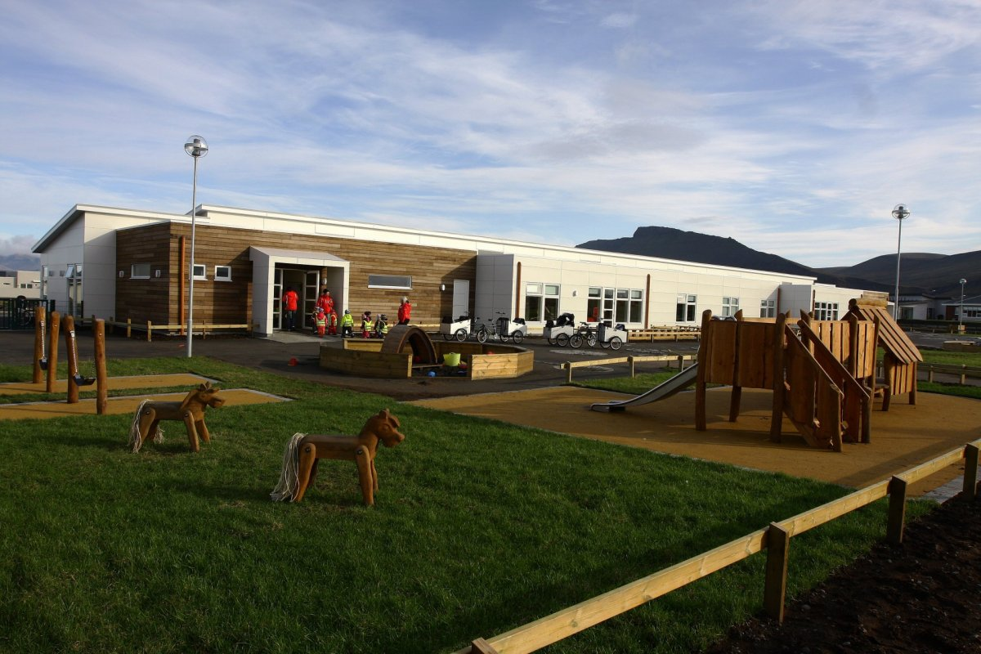
Akrasel
First Unesco kindergarten in Iceland
Have received 6 green flags
Has 48 employees and 150 children
It has 6 classrooms and they cover children from the ages 1-6 years old
4-7 teachers or staff work in each classroom

Slide 3
Reduce
At our webpage akrasel.is we have Environment Of the Week.
We use multipurpose bags for children's wet and dirty clothes
Food waste – we had a competition between departments to bring down food waste. We did very well. The league that had the least food waste that week got a trophy.
And so one…
But we are very proud of the three biggest project.
Christmas gift to the parent. Made by the children
Flora island plat
Costume for karnivel we call Öskudagur. Children make their costume self.

Slide 4
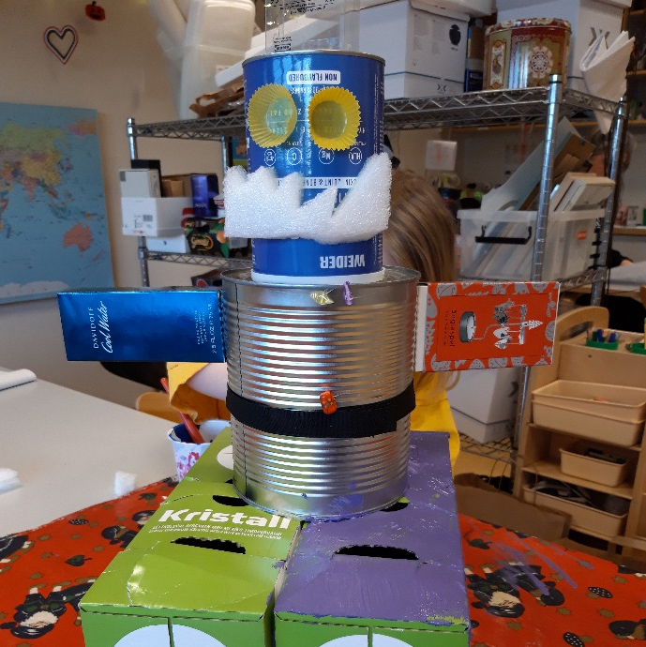
„Homemade“ Christmas gift
In Akrasel the to oldest groups make a christmas gift to their parents out of recyclable materials available at school
.The children have to use their initative and creativity to create this gifts

Slide 5
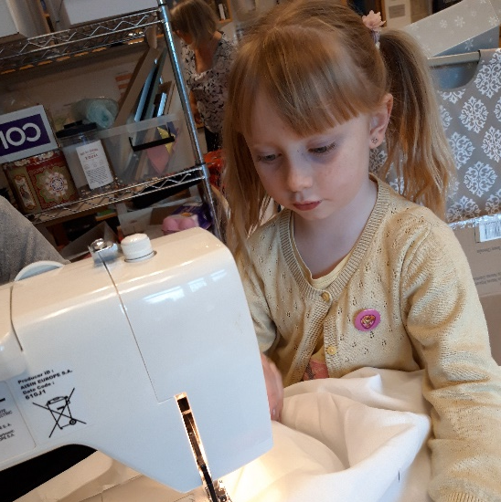
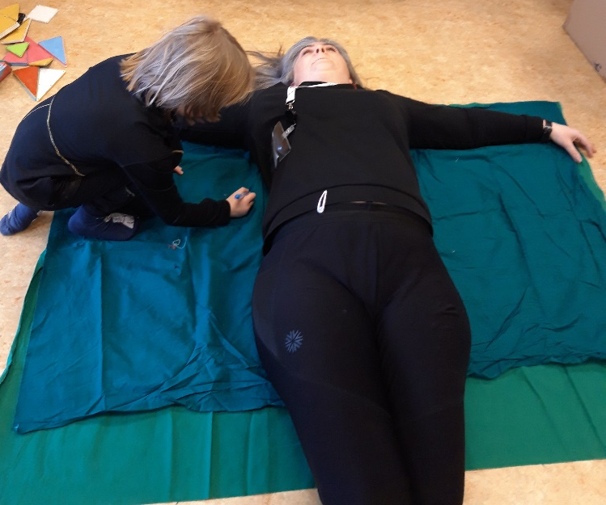
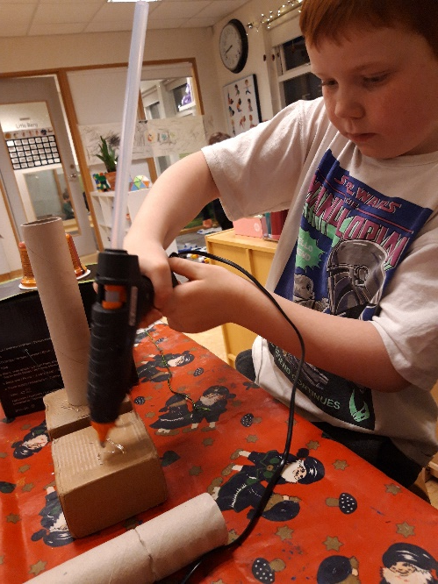
Practice
The first thing the child does is decide what they want to give their parenst
Then they tell the teacher what they want to make, and draw a picture of it
Then the child finds the material the want to use to make the gift.
The teachers help them one the way

Slide 6
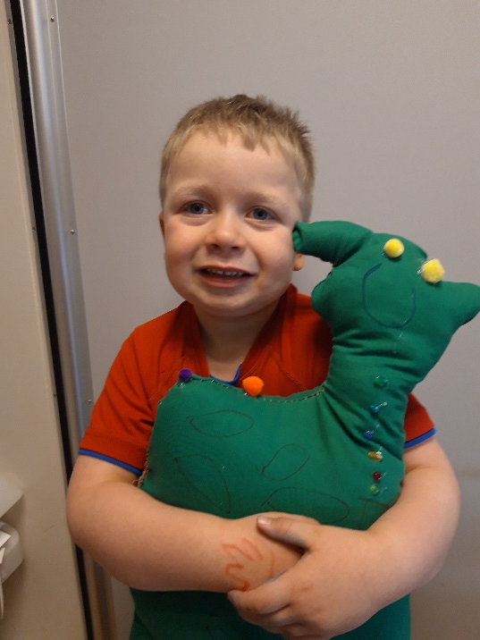
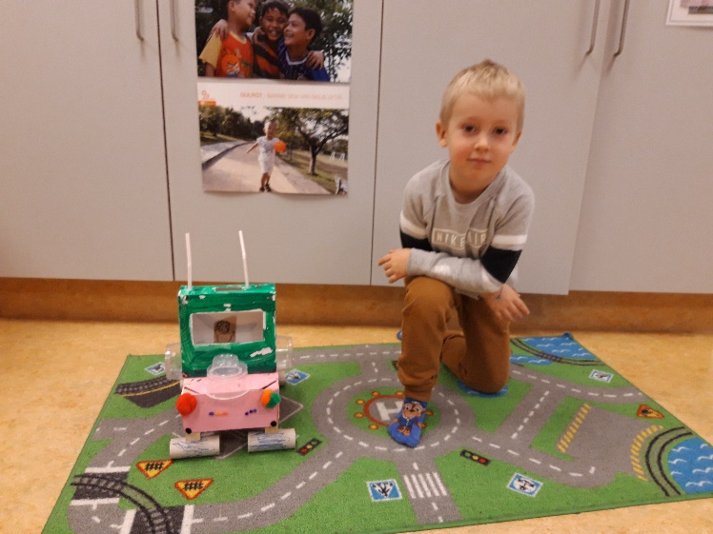
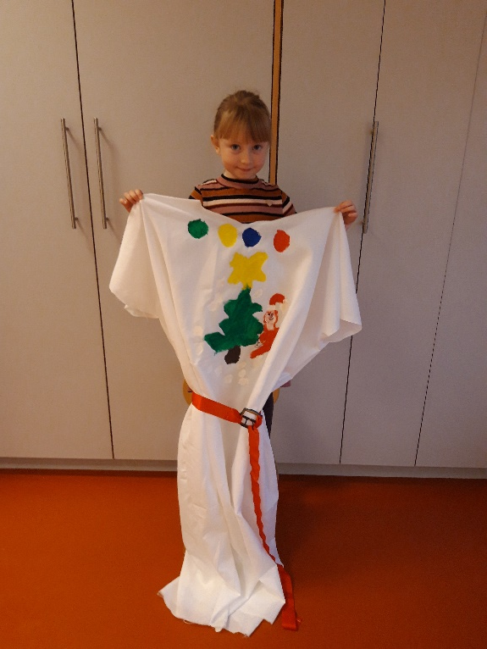
This is a very fun project where you see how imaginative and resourceful the children are.
The children have made dresses, guitars, cars, computers and teddy bear among other things

Slide 7
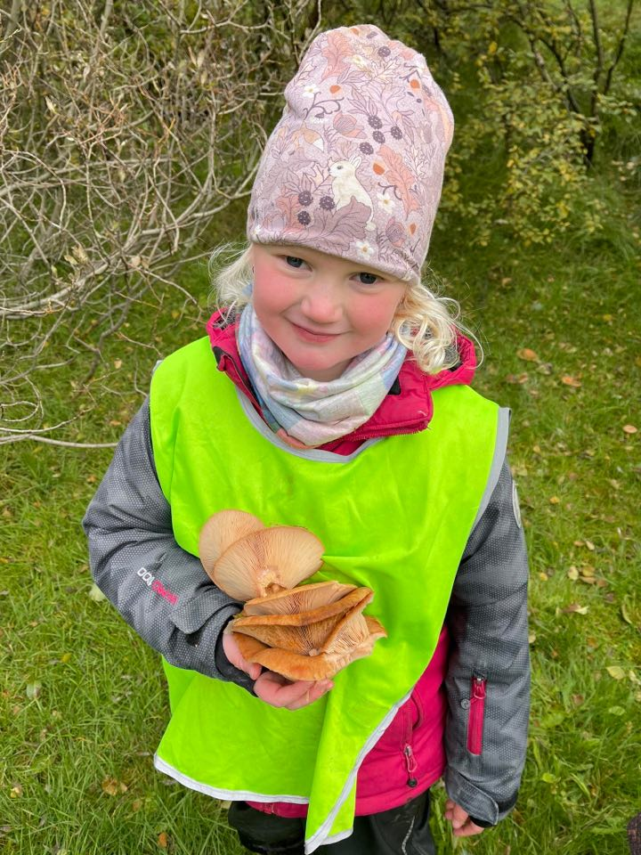
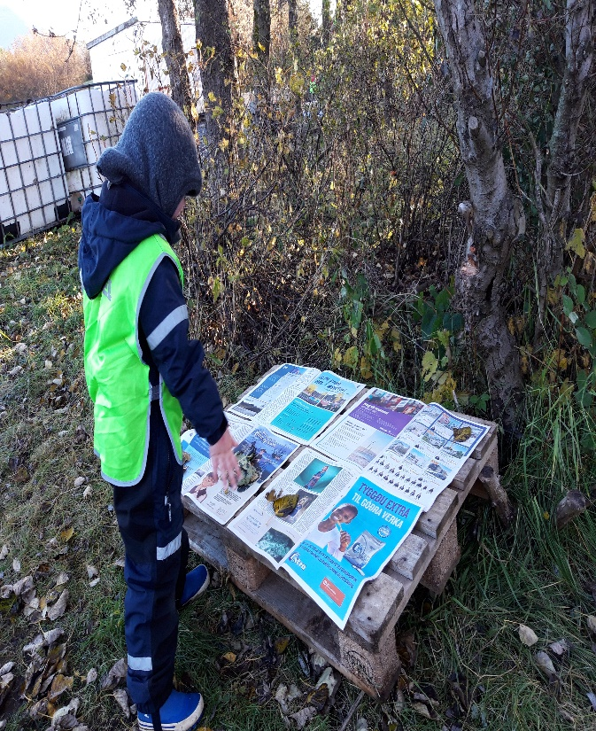
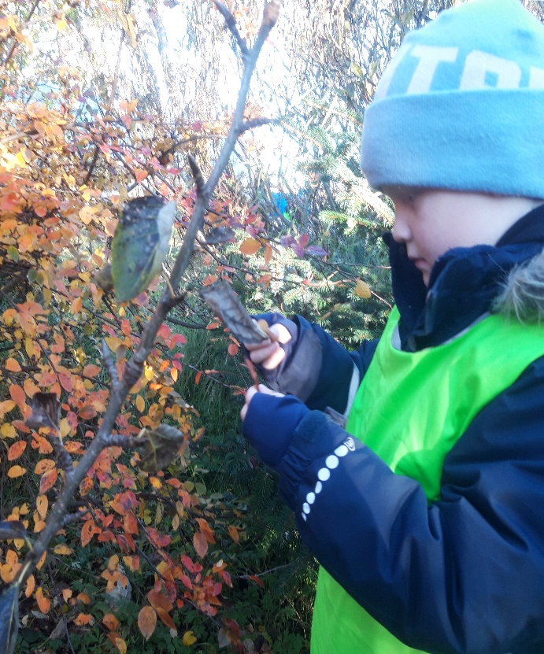
Flora of Iceland
The children learn about the flowers and plants in our local environment.
They go on a field trip and find some plants that they pick up and bring back to the school where the plant are dried.

Slide 8
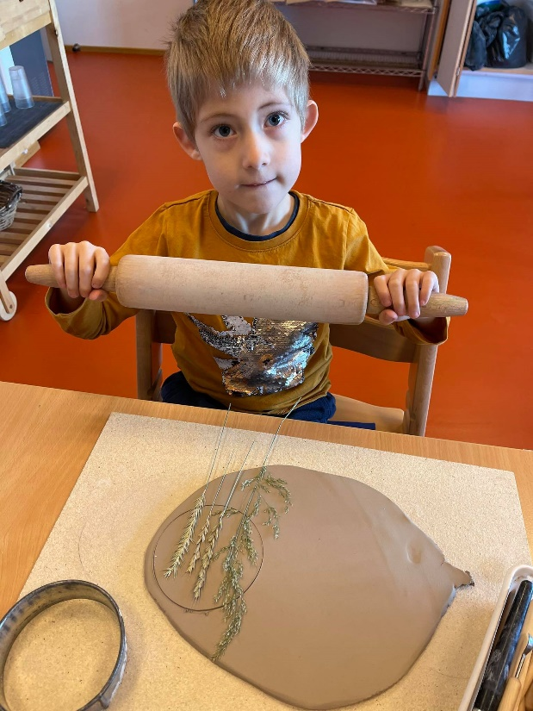
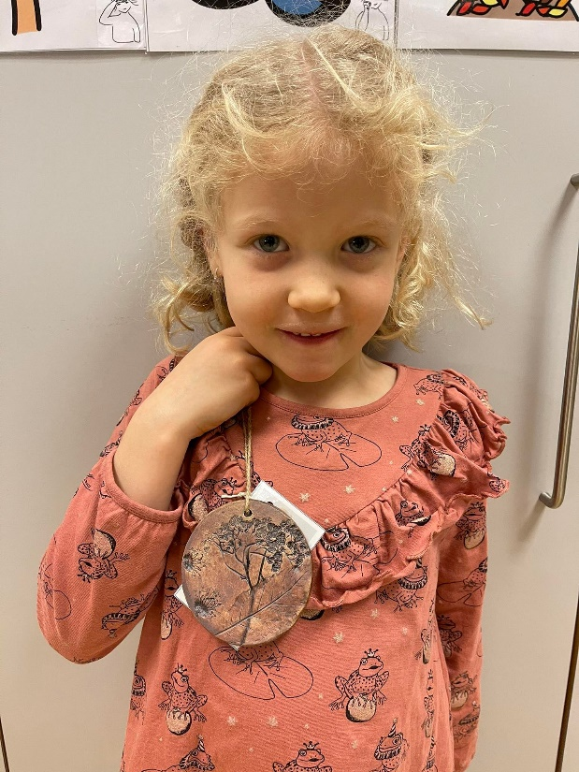
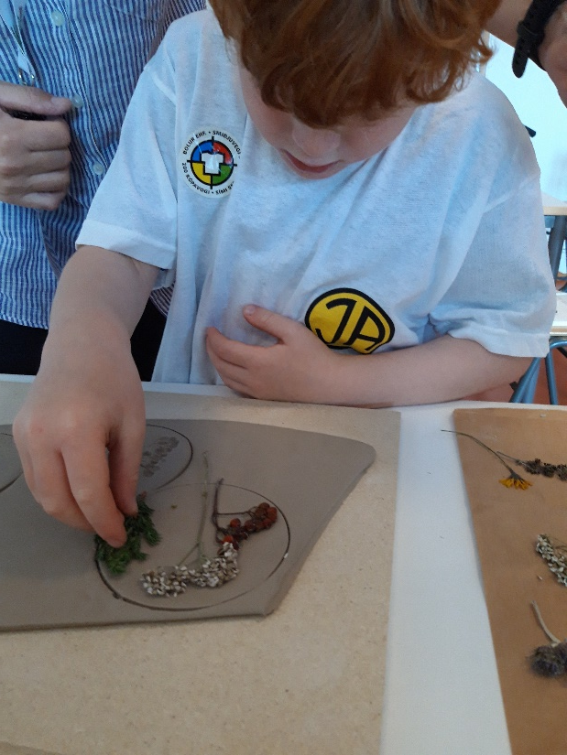
When the plants wear dry, we put them on clay and made plate.
We sold the plates to parents and the profit went to our fundraising project, but we are supporting a young boy in a children’s village on the Ivory Coast in Africa

Slide 9
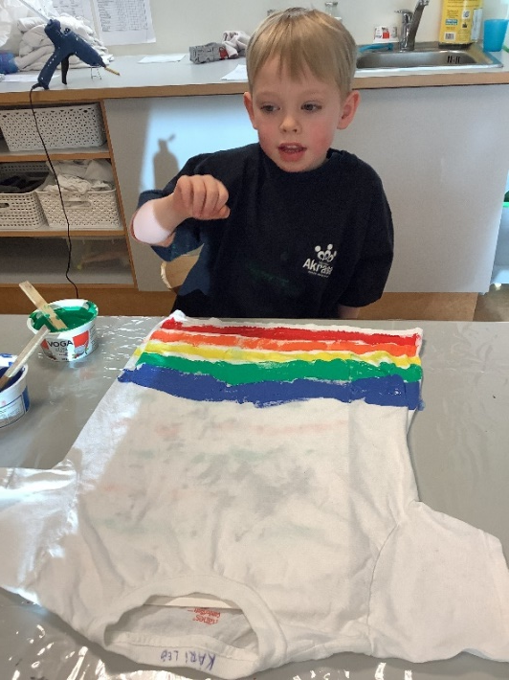
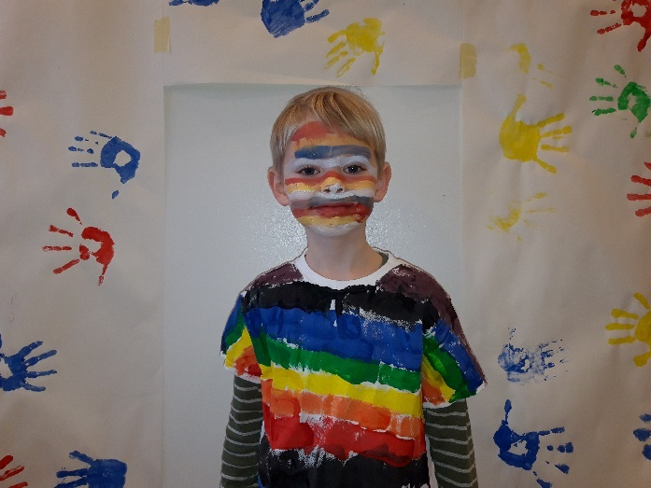
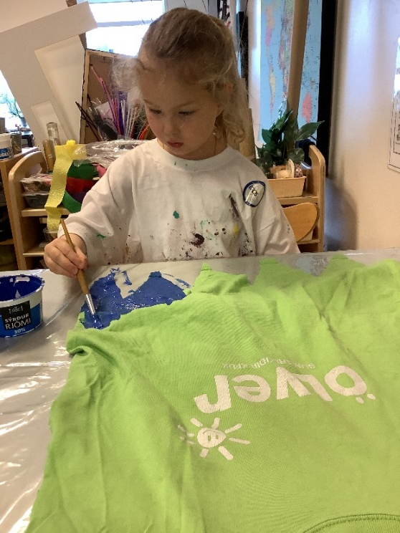
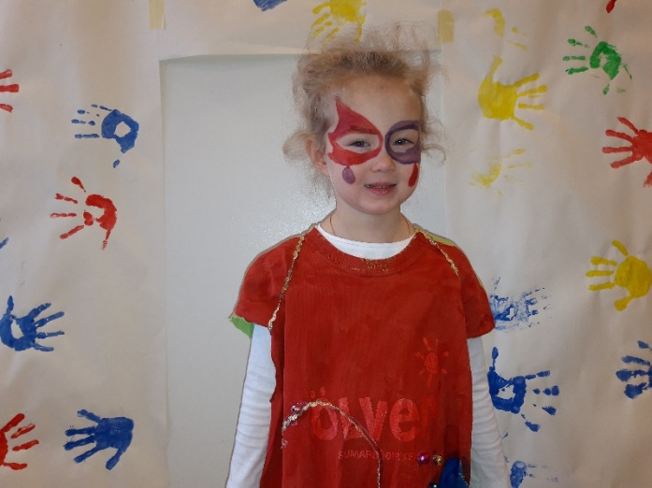
Öskudagur
.
In end of February or beginning of March every year we have a day called Öskudagur or ash Wednesday in Iceland. On this day children wear costumes and sing and get candy in return.
On Akrasel the children have brought an old t-shirts from home and made their own costumes which they use on this day.
Here does also their creativity and imagination play a big role.

