Slide 1
Akrasel kindergarden
Unesco- and Eco school in Iceland

Slide 2
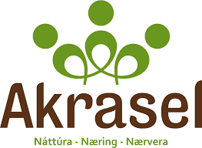
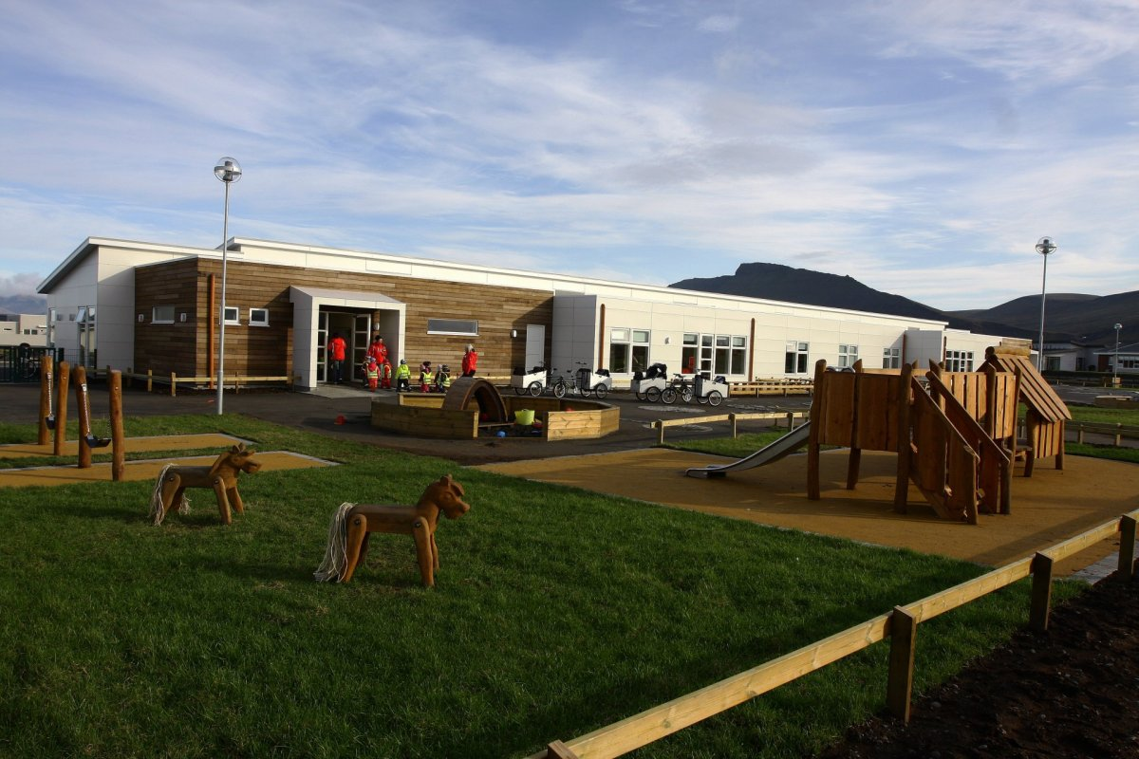
Akrasel
First Unesco kindergarten in Iceland
Have received 5 green flags and the 6 is on it´s way to us
Has 48 employees and 150 children
It has 6 classrooms and they cover children from the ages 1-6 years old
4-7 teachers or staff work in each classroom

Slide 3
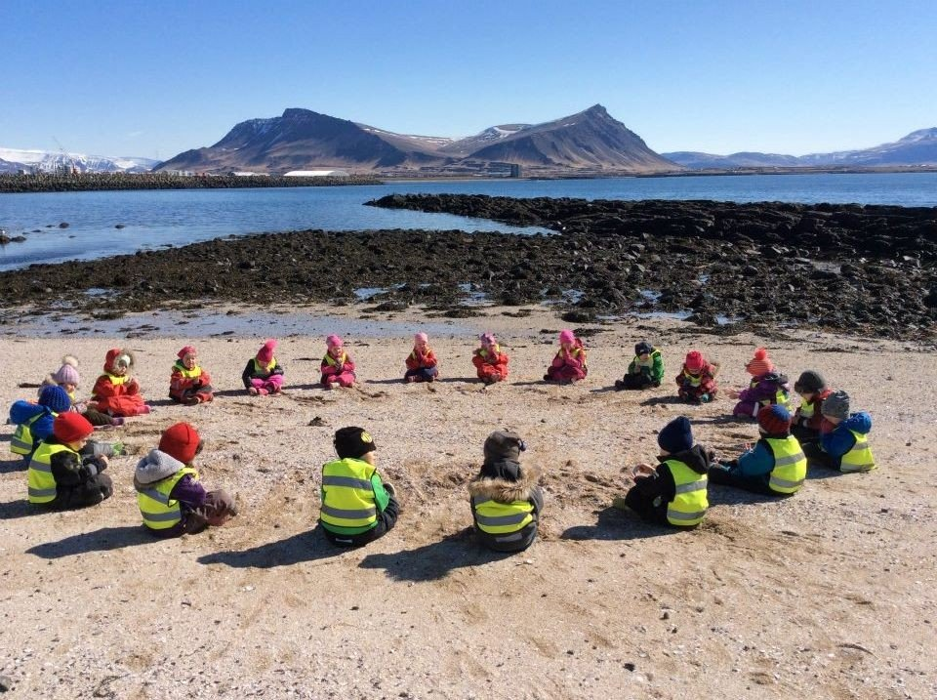
What did we do in COVID times?
We worked on United Nations “The Sustainable Development Goals (SDGs)”
That work gave us the opportunity to become the first UNESCO kindergarten in Iceland
We improved our environmental studies so we could do more with the children and it will be more accessible for new staff members
We stayed open and with limited boundaries
We Improved all the work we do in Akrasel and made handbooks of all the things we do.
Notes:
The Sustainable Development Goals (SDGs) or Global Goals

Slide 4
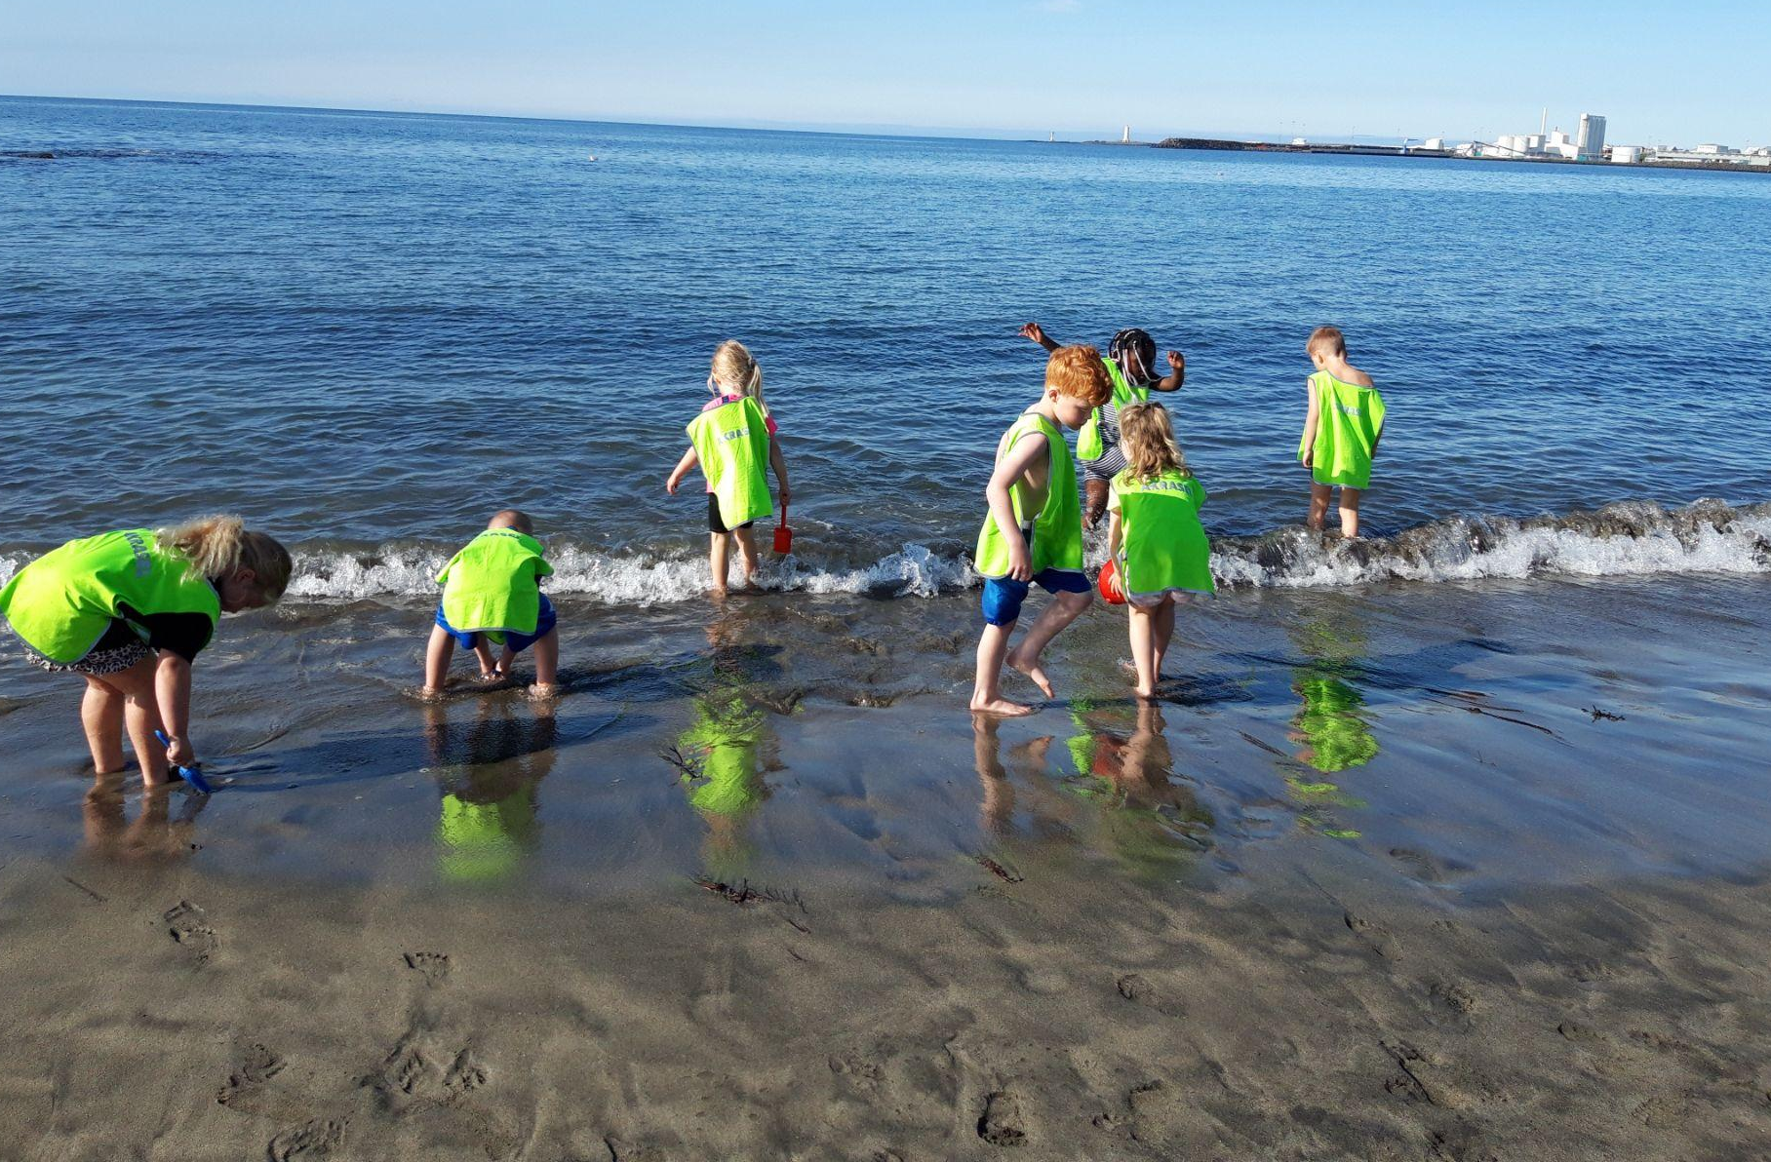
UNESCO school
How did we become UNESCO school?
We studied the United Nations “The Sustainable Development Goals (SDGs)” and involved the goals in our day to day work with the children.
For example we made card game with the goals.
Somebody pointed it out that we were working after many of the SD Goals and we should try to apply. So we did with great success

Slide 5
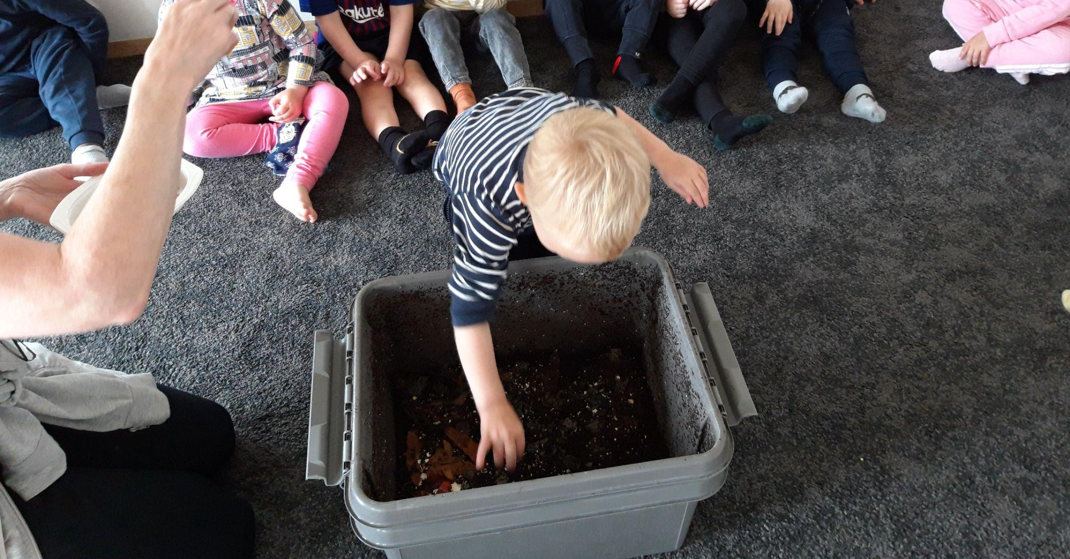
Eco school
Our biggest environmental projects:
Green flag
Compost
And red wigglers worms
Reuse and recycling - How does it work
Learning about food and biodiversity
Blue flag
Yoga
Outdoor teaching

Slide 6
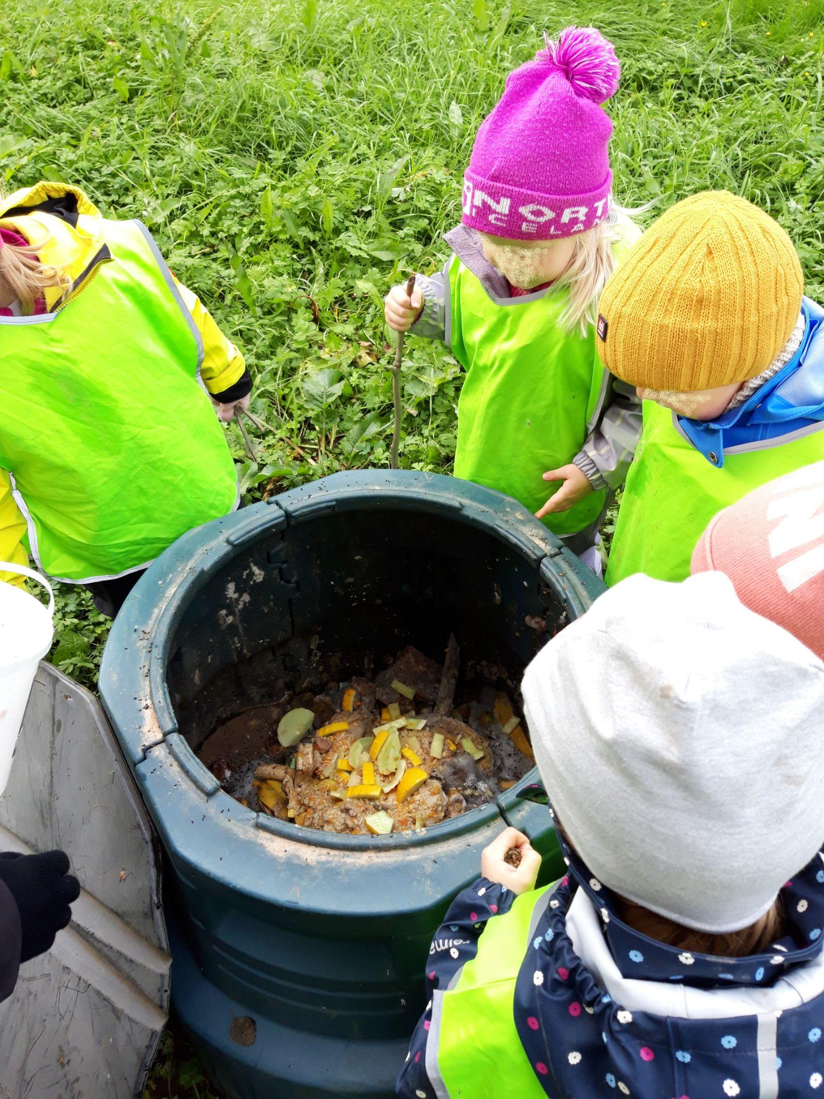
Eco School
The main aim of our environment work at the preschool is:
Enjoy nature through game, play and learning
Respect the nature
Reusing and sorting all kinds of materials
To compost organic waste
To cultivate vegetables and plants in the garden
To save energy and water
Using environmentally friendly cleaning product

Slide 7
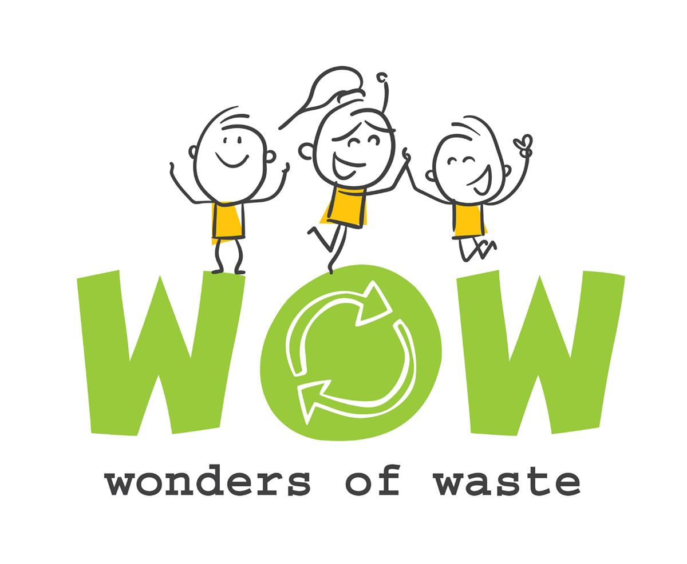
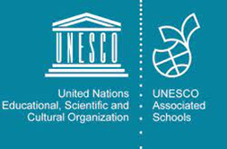
Our Logos

