Slide 1
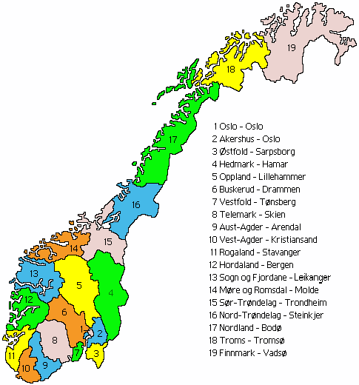
NORWAY

Slide 2
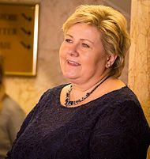
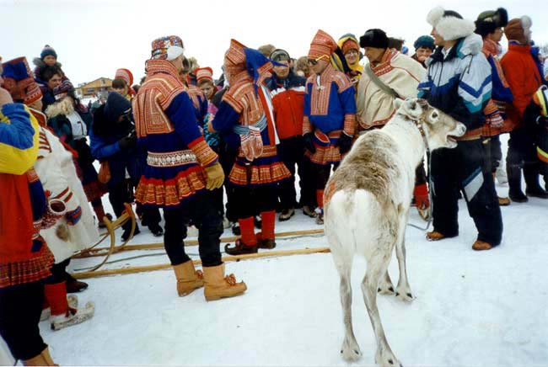
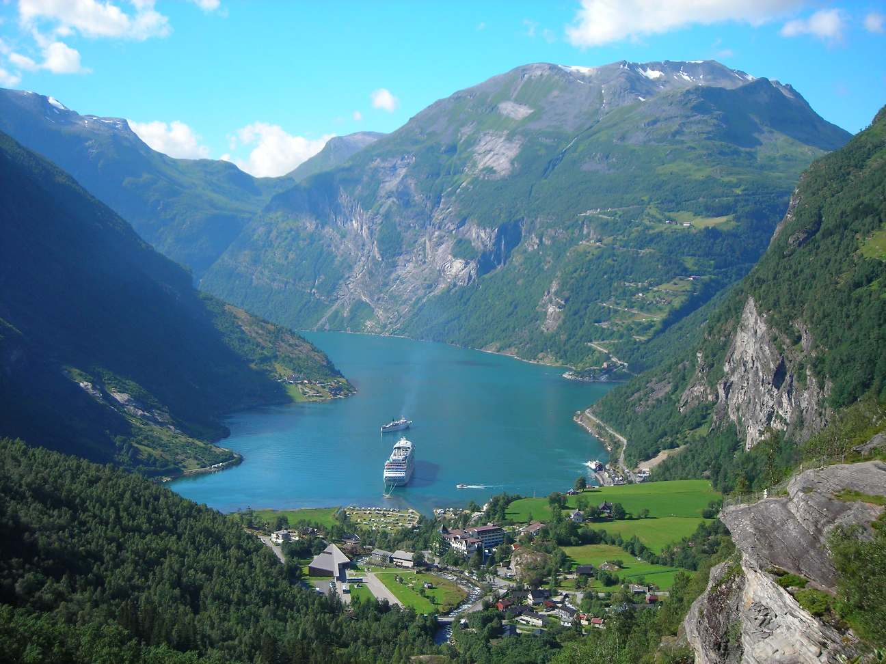
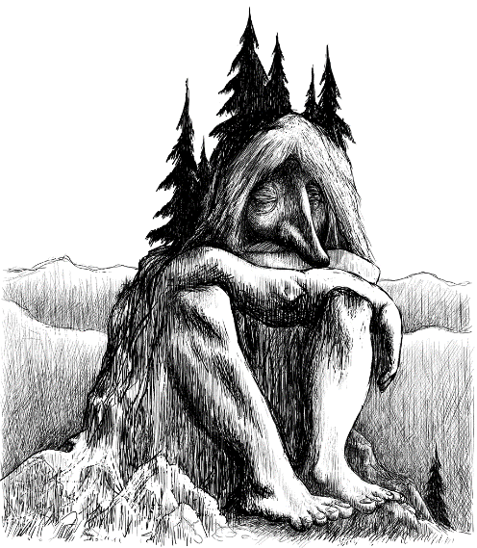
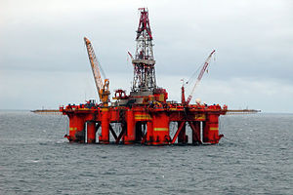
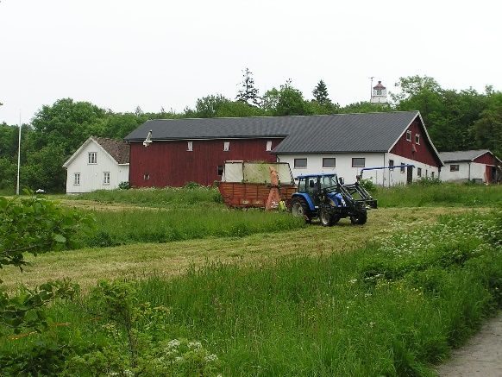

Slide 3
TIME MUNICIPALITY – A PART OF JÆREN
* Population – 18 600, city center 11 000
* Industry – agriculture and oil
* Retail, tourism, hotels and restaurants
* About kindergartens: 11 + 10, 1 farm, 1 sport and 3 churches
* All from 0-6 years old, starts at school at age 6
* Kindergarten Act and national curriculum

Slide 5
HAUGLAND GARDSBARNEHAGE

Slide 6
About the kindergarten:
Kathrine is the owner and her history starting the kindergarten:
In a modern farm
39 children 0-6
11 employed
Our profile
Nordplus – Today a child – tomorrow a leader (together with Akrasel)
Erasmus+ - Eco Farm Kindergartens (together with Nidi Corte Verde)

Slide 7
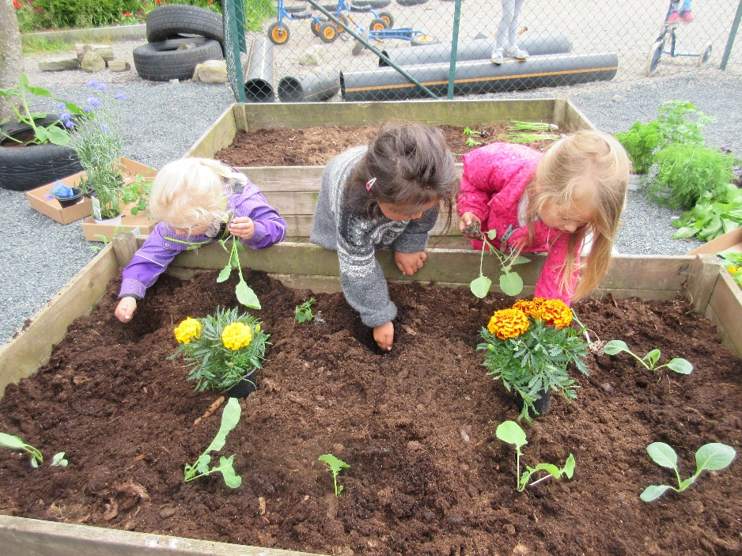
Our profile – special focus on food
From soil to the table
Untravel, short travel, long travel food
To see and to taste
New experiences

Slide 8
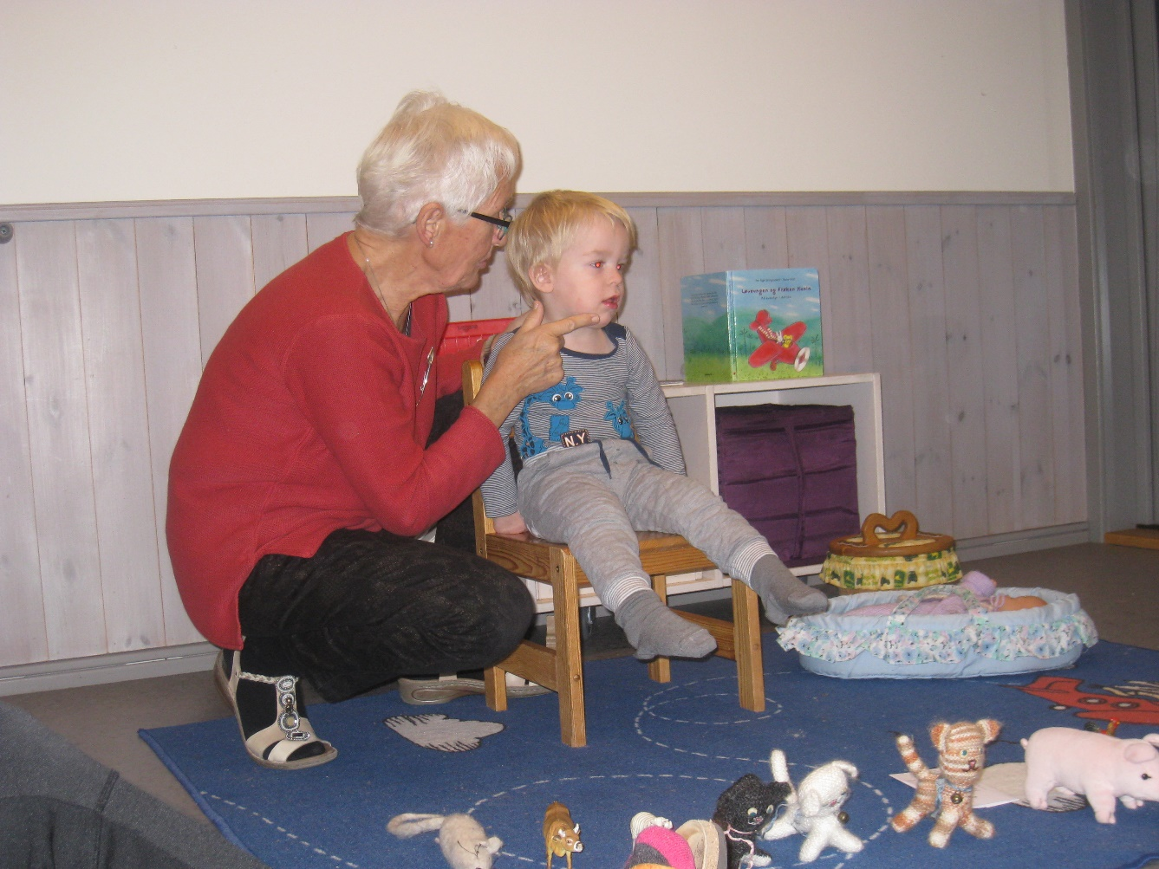
Other importaint focus:
Language
Social skills
Cos
Marte Meo

Slide 9
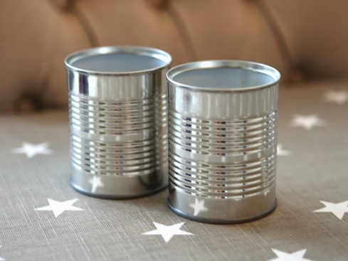
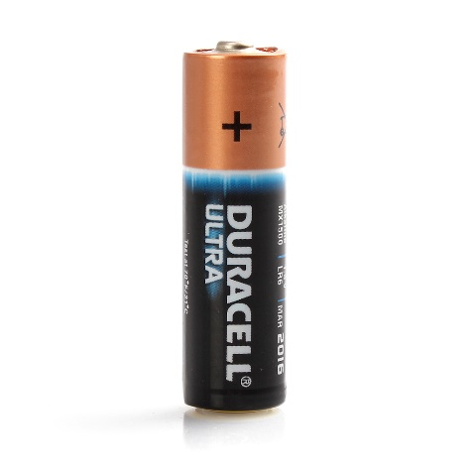
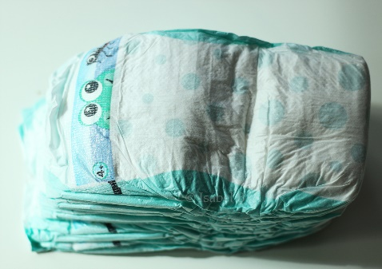
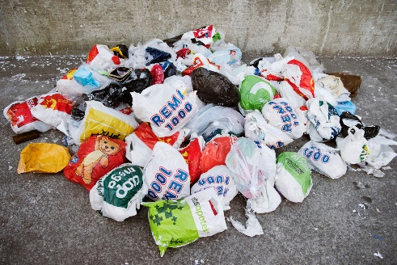
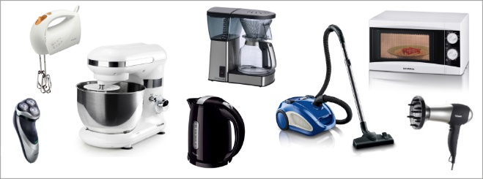
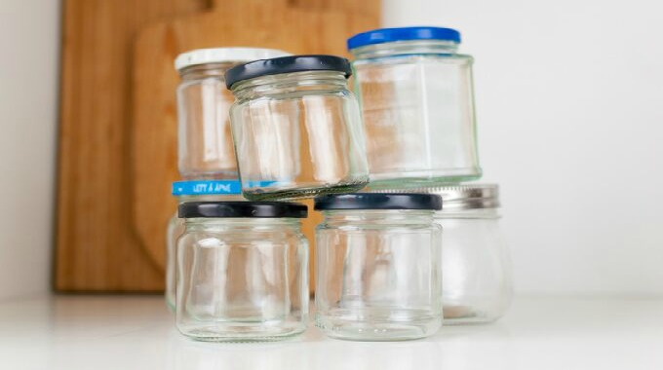
Our top 10 waste:

Slide 10
How to reduce or replace
Milk carton – wash, fold together, deliver to recycle
Food waste – offer less portions to reduce
Cans – deliver to recycling, use as storage, use in art activity to replace
Paper towels – be aware when children use paper to reduse the use
Battery – reduce by choosing long lasting and good quality and also recycle
Dipers – say yes to parents who wants washable dipers
Electronic devices – deliver back to electronic stores
Glas – reuce for cooking, storage, art activities
Plastic – replace with boxes like Tupperware etc. Bag for wet clothes instead of sending home in plastic bag
Drawing sheets – offer smaller white sheets, use both sides to reduce

Slide 11
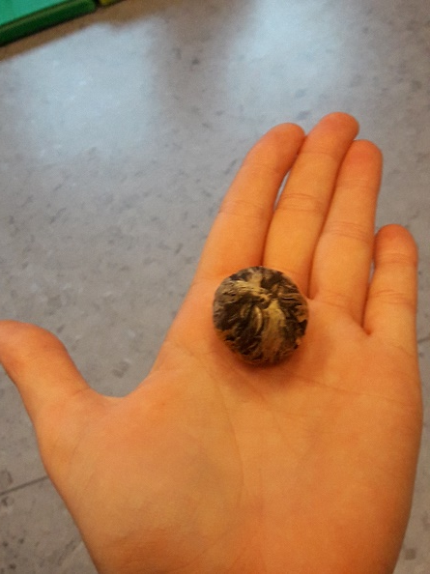
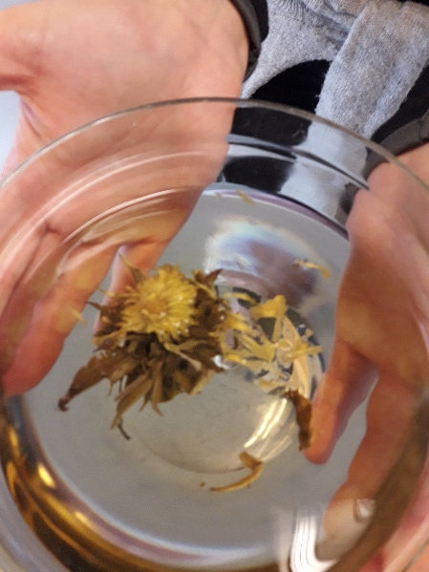
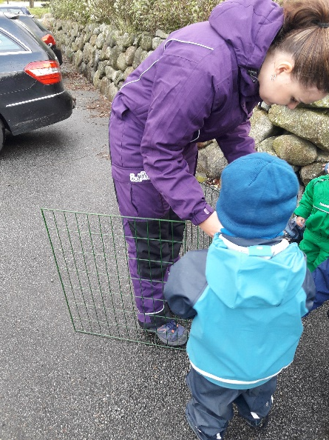
What we have done so far:
The flower need water to become a flower
Building a compost

